Slide 1
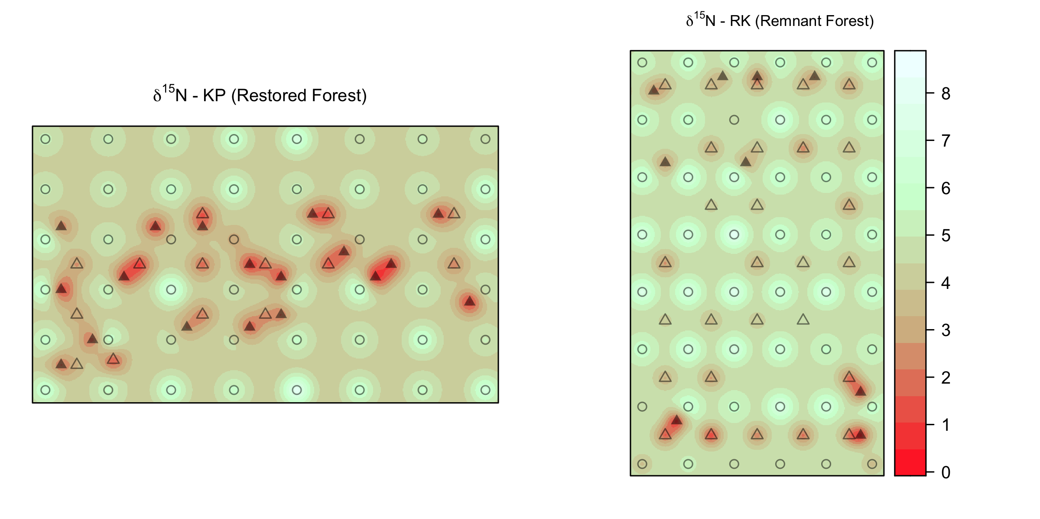
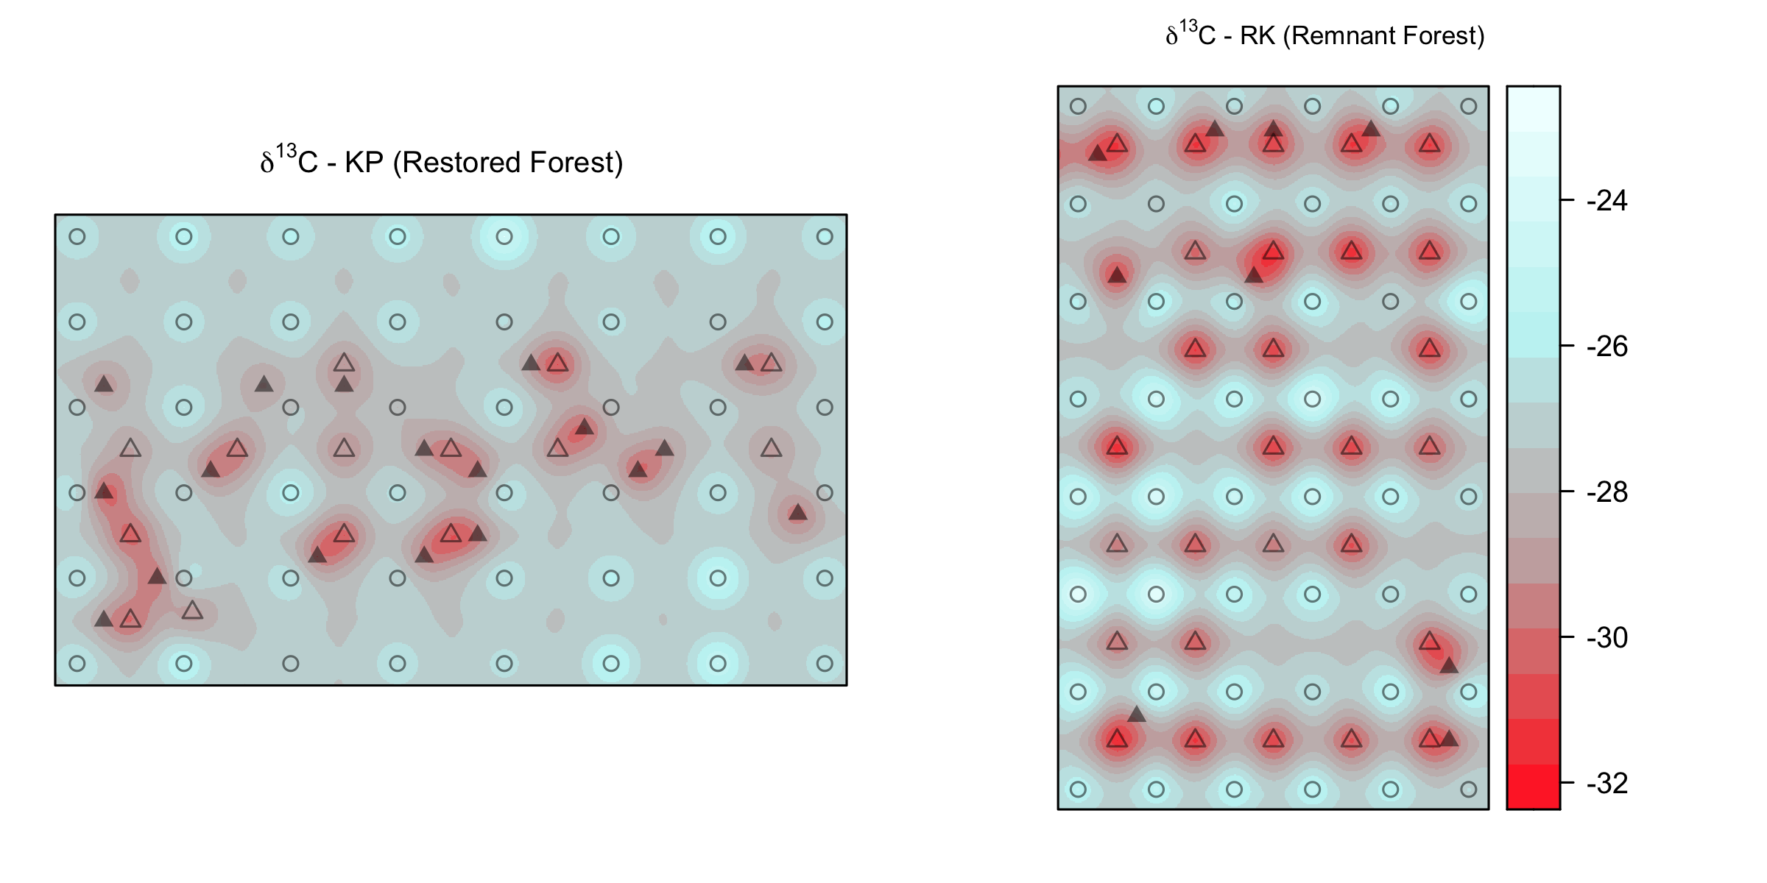
A
Soil + foliar δ¹⁵N
C
Soil + foliar δ¹³C
Koa Plantation (KP)
B
δ¹⁵N ‰
D
δ¹³C ‰
5 m
N
Acacia koa
Rubus spp.
soil
Remnant Forest (RK)

